Slide 1
Axon & Shipt Audit App
March 2022

Slide 2











What is Axon?
Axon is a platform aggregation layer that provides datasets and key real time fulfillment metrics to tenants and consumers to drive Fulfillment operations.
Axon consumes data from multiple sources to enable specific views or use cases for store level and aggregated data points.
ePick
MPM
Workload Prioritization
Houston
gPack
myDay
SPACE
Greenfield
Capacity Management

Slide 3




Why is Axon important?
Ensures Data
Alignment
Provides Consistent
Stability
Unlocks Future
Use Cases
Can Expand to
Additional Nodes
Axon alleviates metric discrepancies when comparing multiple fulfillment applications by providing core data to multiple sources.
Axon is able to organize data in a centralized location to ensure logic and patterns do not have to be repeated.
Built on tried and tested patterns with high availability, durability and reliable caching and fallbacks.
Axon can act as a layer to protect stores from upstream failures that can cause disruption and/or failures.
Tenants and consumers will be able to focus on iterating and improving their algorithms without worrying about where to gather their data from, the accuracy of the data and the stability of the data.
Different tenants and personas may be interested in different data points and metrics. Axon can join different datasets from multiple sources to quickly present a story in real time.
Axon’s data and patterns can become portable if a contract is established and abstracted.

Slide 4

Vision
Graph title
Provide fast, consistent and reliable real time operational data to allow end users to seamlessly and intuitively drive to-the-minute Fulfillment decisions to deliver on guest expectations.
Reusable backend components provide flexibility to unlock new use cases and add additional data points quickly.
Support a data catalog that acts as a Fulfillment source of truth.
All data points and metrics have the ability to be aggregated by hierarchy.
Ability for multiple consumers to source streamed real time data in parallel without performance concerns.

Slide 5
How do we get there?
Graph title
2022
2023
2024
Modernize Technology Stack
Discover and define domain.
Build the foundation by modernizing MPM, Houston, WOPr and Capacity Management use cases.
Houston Alerting POC.
Axon + Greenfield POC.
Unlock New Use Cases
Leverage modernized APIs to unlock new use cases.
Self Service Alerts in Houston.
Axon + Greenfield expansion.
Meet “Certified Data” requirements/criteria.
POC real time reporting for other fulfillment nodes.
Become a Certified Data Source
Tenants have the ability to define their own datasets from Axon’s catalog.
Axon is the source for majority of Greenfield’s Fulfillment historical data.
Continue to increase stability and speed.
Real time reporting for all fulfillment nodes.

Slide 6





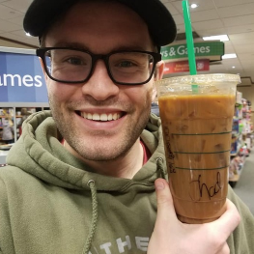


Meet the Axon team
Ali Obler
Lead Product Owner
Angeli Corral
Sr. Engineering Manager
Baskar Natarajan
Lead Engineer
Ben Hess
Lead Engineer
Abdul Ashwood
Engineer
Jack Morgan
Sr. Engineer
Nancy Selvam
Engineer
Eric Jensen
TLP

Slide 7
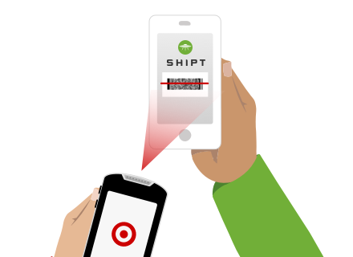
Shipt Audit App

Slide 8
Shipt Audit App
Effectively guides store team members through a quick and seamless audit for pre-paid Shipt orders to create a positive checkout experience for Shipt Shoppers and ensure our guests are satisfied with their order.
Current State
Shipt Audit App is a stand alone app on the myDevice that was stood up very quickly in 2019.
This app acts as an impression of control for Shipt shoppers.
Shipt Audit App is used for “Scan and Go” or “SAG” Shipt orders. Meaning, the Shipt order was placed via Target.com or the Target app.
Process owned by Assets Protection and Service & Engagement.
Guest Advocate conducts the audit – Assets Protection utilizes reporting for investigations.
Future Scope
Kiosk POC in two Birch stores (October 2022)

Slide 9
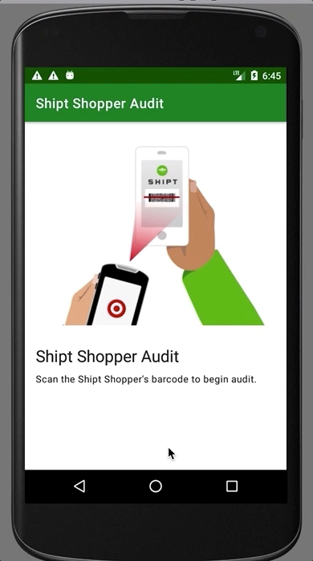
Shipt Audit Demo (Non AB)
Successful Audit
Step 1: The Guest Advocate scans the Shipt shoppers barcode to begin the audit.
Step 2: An itemized list of the Shipt shoppers order appears.
Step 3: The Guest Advocate visually verifies that three of the items match what it in the Shipt shoppers order.
Note: The Guest Advocate can pick any item to verify and there are no scans involved in this step.
Step 4: The Guest Advocate confirms that the three items match the Shipt shoppers itemized list and tap “Looks Good”.
Step 5: An Audit Complete page appears and the Guest Advocate taps “Dismiss” to begin another audit.
Unsuccessful Audit
Step 1: The Guest Advocate scans the Shipt shoppers barcode to begin the audit.
Step 2: An itemized list of the Shipt shoppers order appears.
Step 3: The Guest Advocate visually verifies that three of the items match what it in the Shipt shoppers order.
Note: The Guest Advocate can pick any item to verify and there are no scans involved in this step.
Step 4: If the Guest Advocate identifies an item that is not listed within the order they tap “Extra Item”.
Step 5: The Guest Advocate should inform the Shipt shopper that the extra items must be removed and that if the guest would like the item that they will need to place a new order.

Slide 10
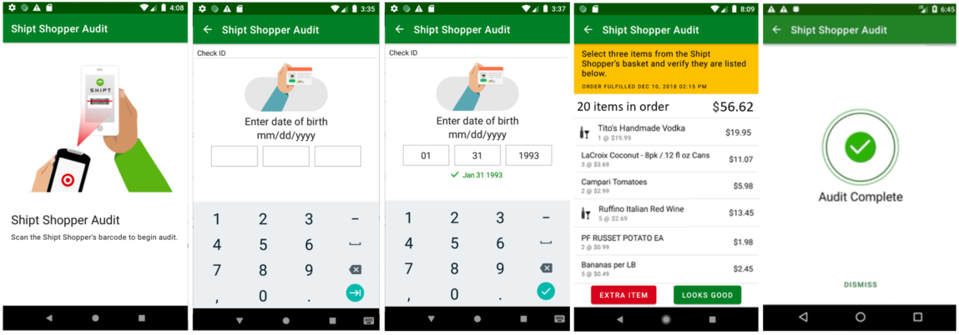
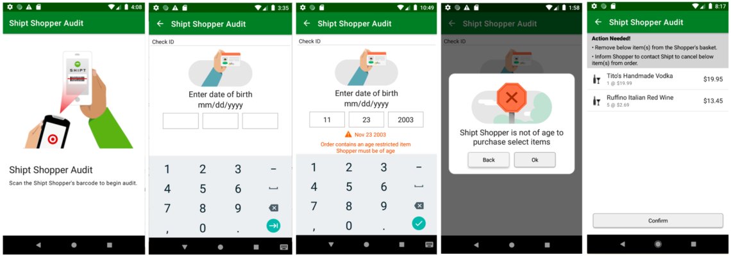
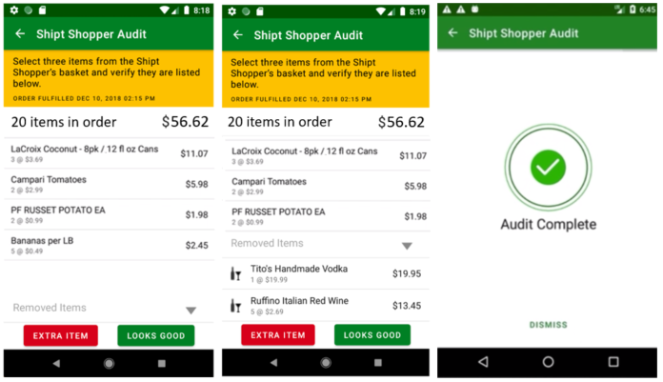
Shipt Audit – Adult Beverage Flows
Happy Path (AB Item, Guest Advocate of age, Shipt Shopper of age, “LOOKS GOOD” audit)
Exception Flow (AB Item, Guest Advocate of age, Shipt Shopper NOT of age, Remove Items, “LOOKS GOOD” audit)

Slide 11
Questions?

